Slide 1
EasyHealth App Screenshots
Team Members:
Hemanth reddy Ramala (team lead)
Jashwanth reddy gangula
Karthik Yogendra bangera
Meghana bhojaraj joshi
Rama teja repaka
Rishit reddy muthyala

Slide 2
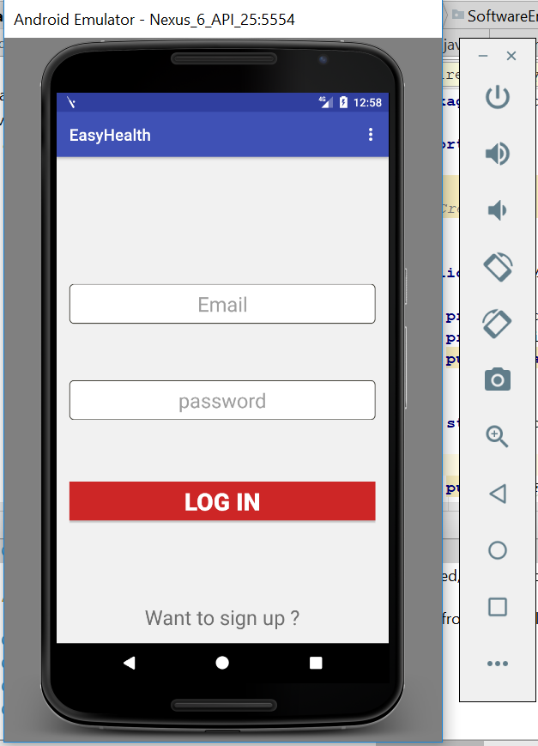
Login Screen
This is the login screen for EasyHealth.
If registered, user can enter the email and password and click on login.
If a new user, click on “Want to sign up?”.

Slide 3
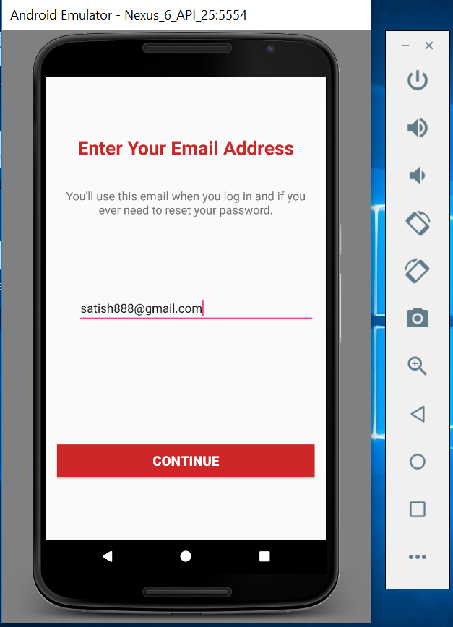
Create New User
Enter the email id (first step on signing in a new user).

Slide 4
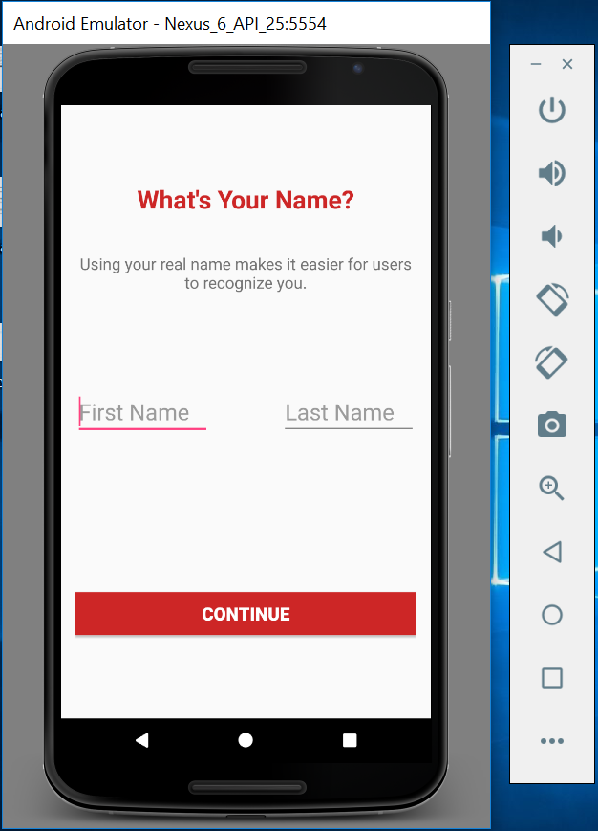
Create New User(Contd.)
Then enter the first and last name.

Slide 5
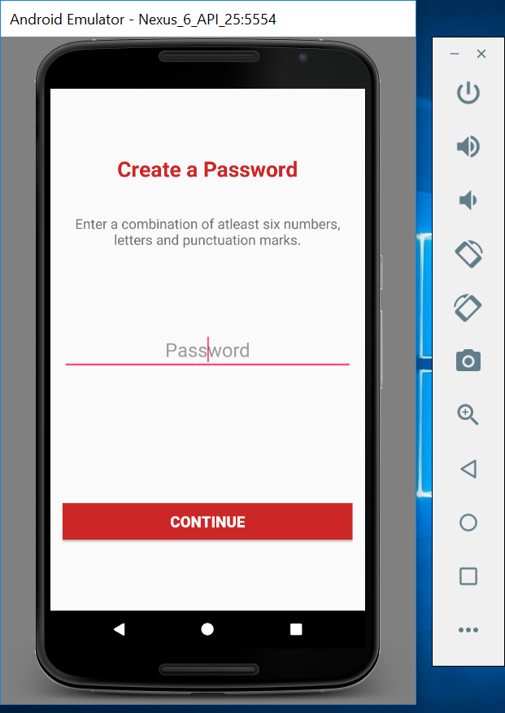
Create New User(Contd.)
Then enter the password for the new user.

Slide 6
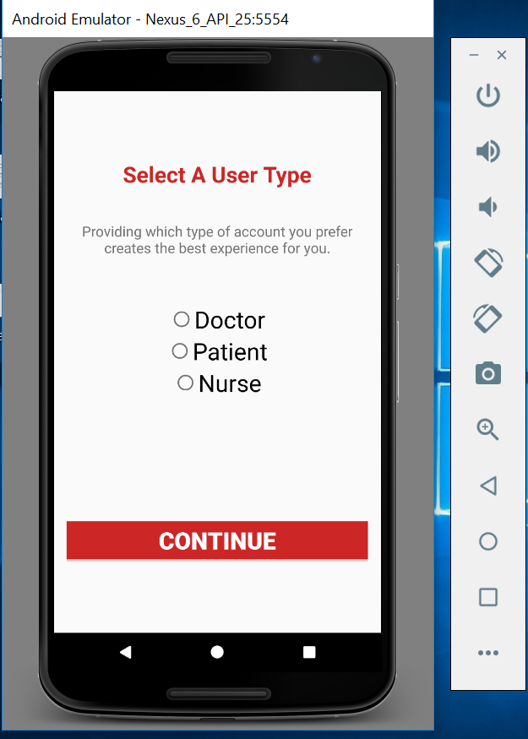
Create New User(Contd.)
Choose the profile suitable to the user.

Slide 7
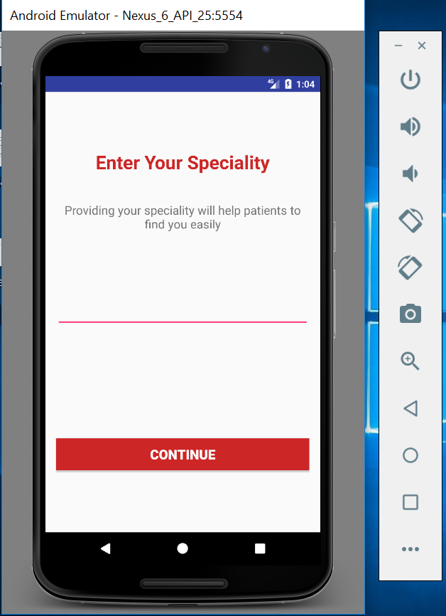
Create New User(Doctor)
If the new user is a doctor, enter the speciality.

Slide 8
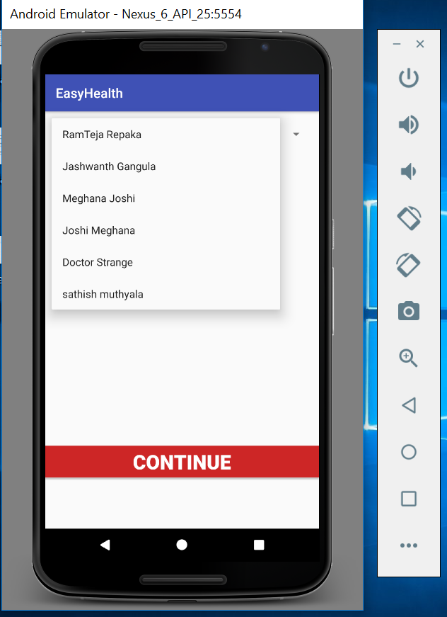
Create New User(Nurse)
If the new user is a nurse, enter the doctor you report.

Slide 9
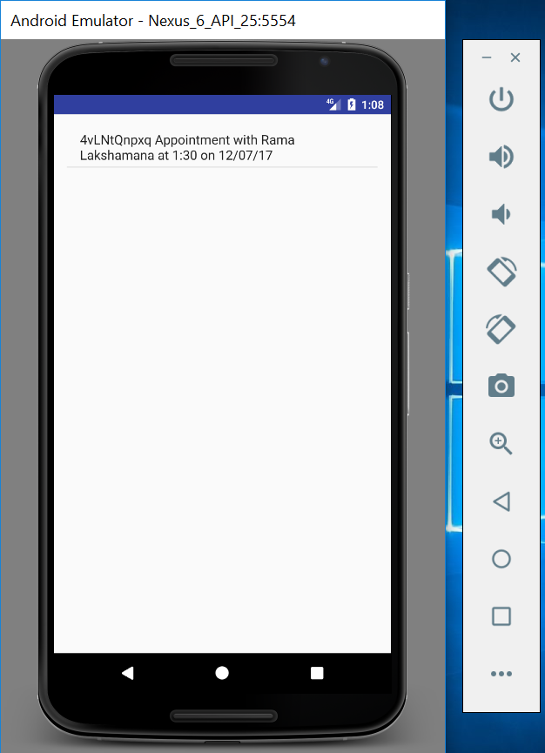
Doctor Appointments
If the doctor is an old user, on login he/she would see the list of appointments.

Slide 10
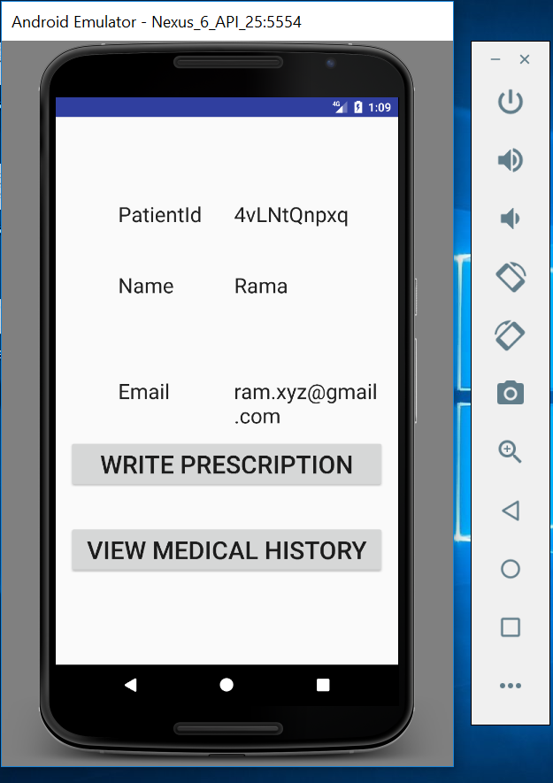
Doctor Appointments(Contd.)
On selecting any appointment, the doctor would be able to see further details of the patient.
The doctor can then either write a prescription or view the medical history.

Slide 11
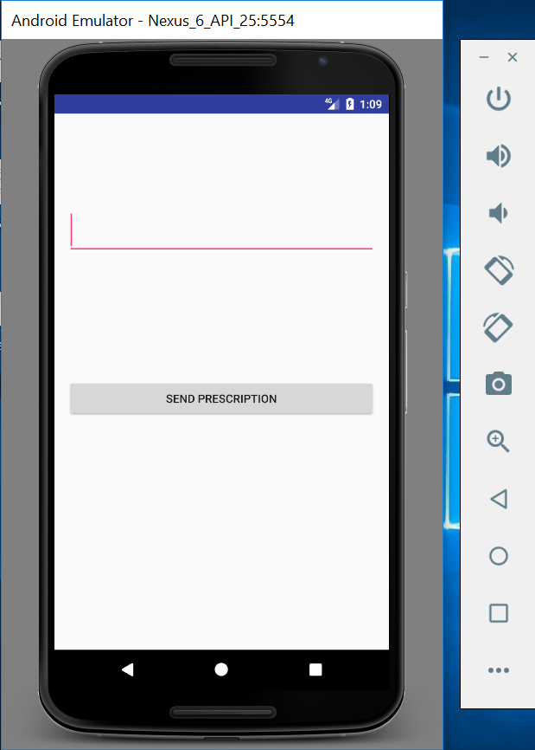
Doctor Prescriptions
On clicking write prescription, the doctor can write and send the prescription for the respective patient.

Slide 12
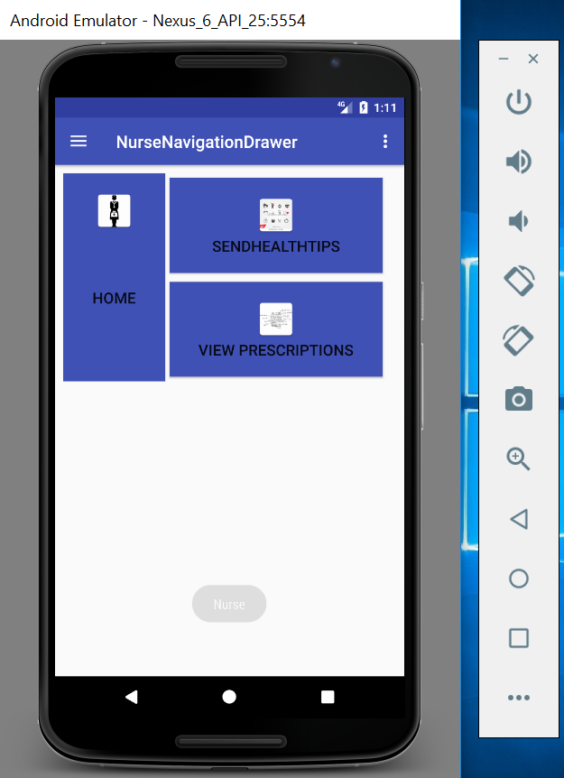
Nurse Dashboard
If the nurse is an old user, on login he/she would see a dashboard .
On click of home, the nurse would see his/her details as seen in the live demo in class.
On click of send health tips, there would be health notifications sent to the patients as seen in the live demo in class.

Slide 13
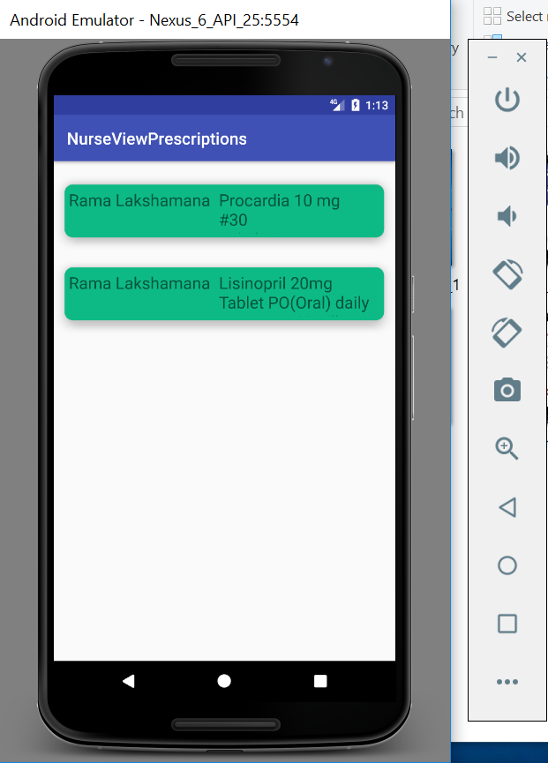
Nurse Home
On click of view prescriptions, the nurse would see prescription details of patients given by doctors that the respective nurse reports to.

Slide 14
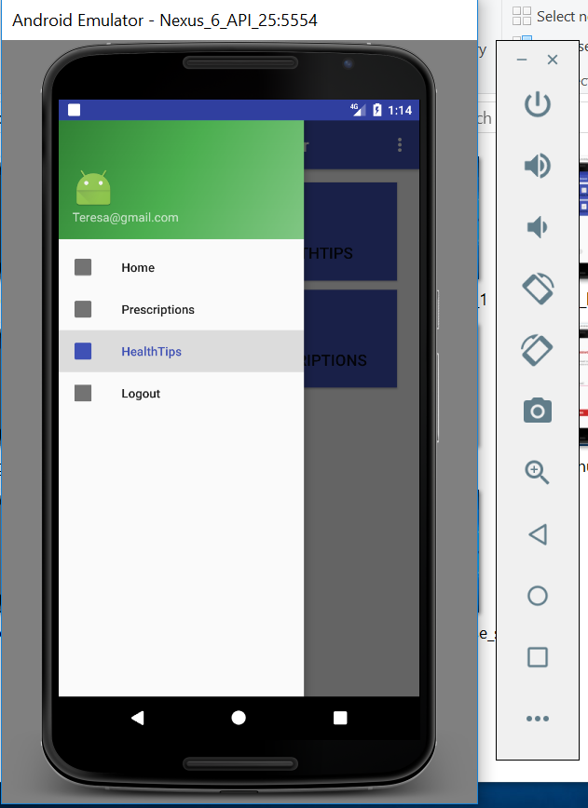
Nurse Left Navigation
This is the left hand navigation menu, of the nurse profile.

Slide 15
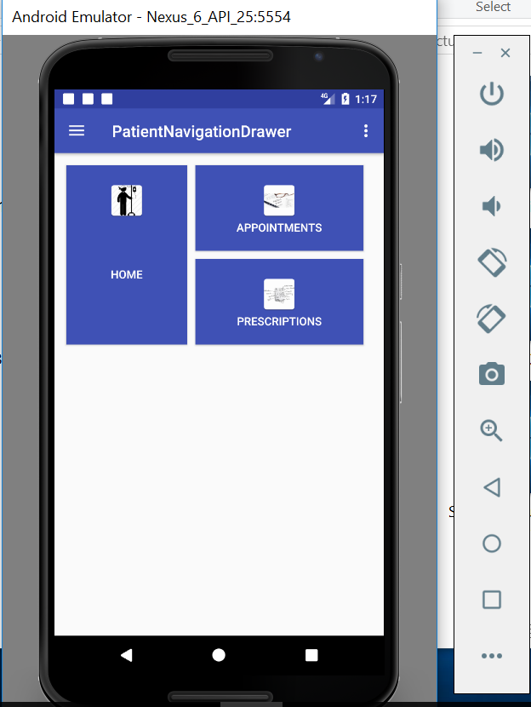
Patient Dashboard
If the patient is an old user, on login he/she would see a dashboard .
On click of home, the patient would see a list of all doctors he/she could select from.
On click of appointments, the patient would see a list of all his/her appointments.
On click of prescriptions, the patient would see a list of all his/her prescriptions.

Slide 16
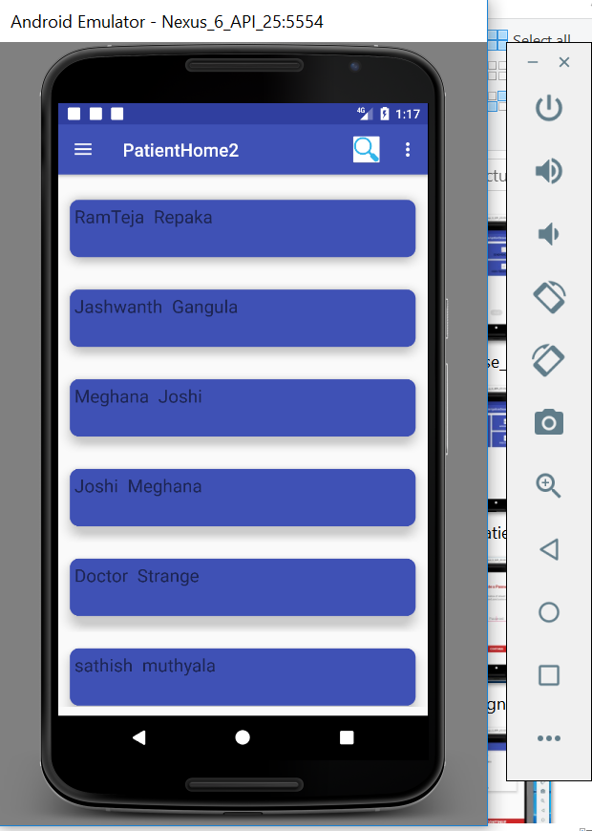
Patient Home
On click of home, the patient would see a list of all doctors he/she could select from.

Slide 17
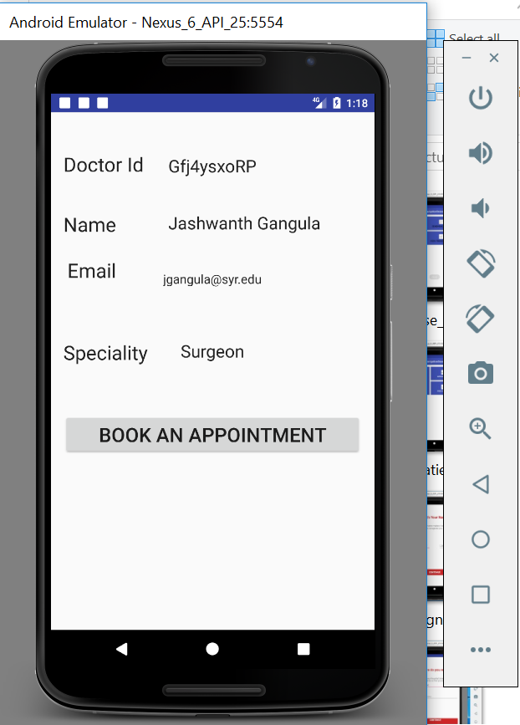
Patient Book Appointment
On selection of a doctor, the patient would see details related to the doctor.
The patient can then decide to book an appointment.

Slide 18
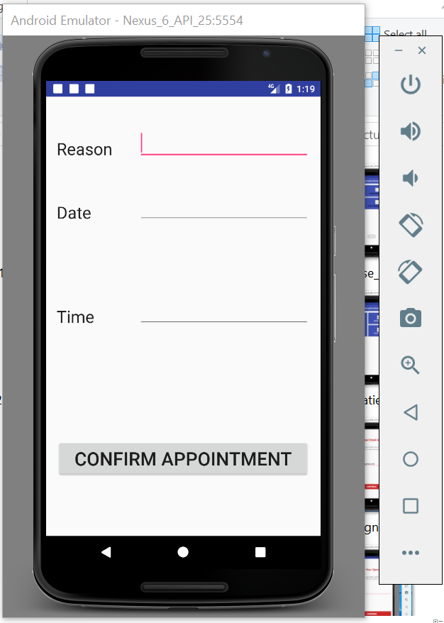
Patient Book Appointment
On clicking book an appointment, the patient would need to add a reason, date and time to later confirm the appointment.
On clicking confirm appointment, both the patient and the doctor would see the details of the appointment.

Slide 19
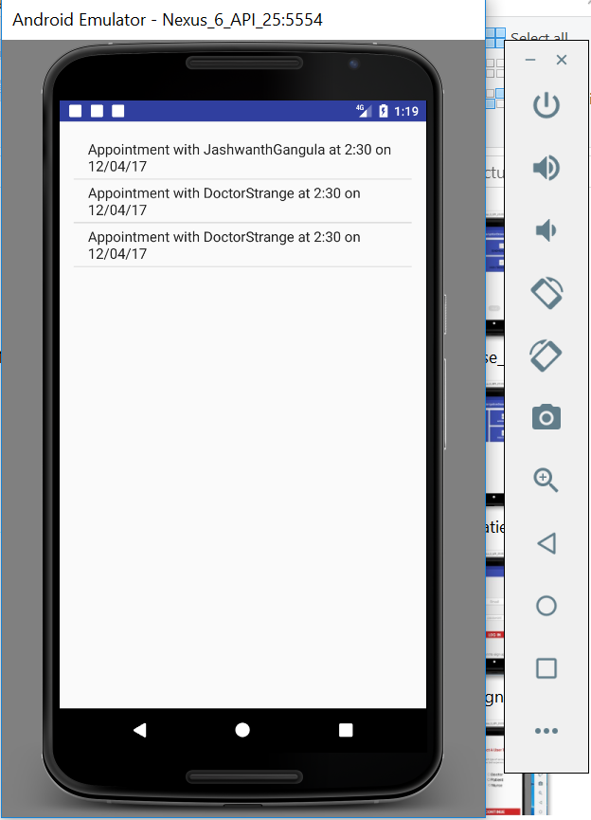
Patient Appointment Details
On click of appointments in the patient dashboard, the patient would see a list of all his/her appointments.

Slide 20
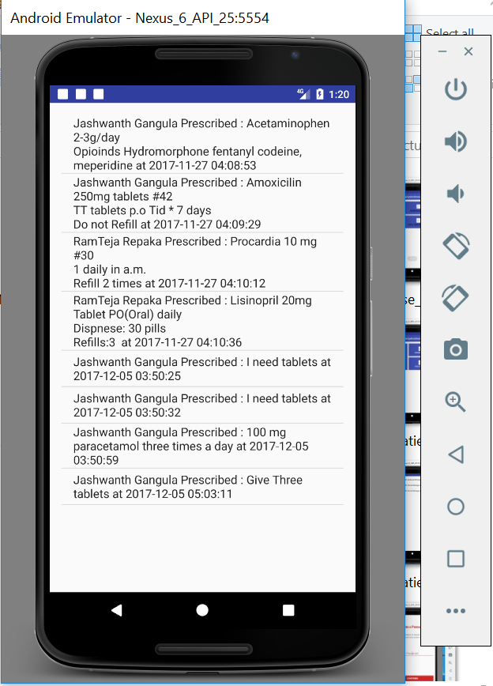
Patient Prescription Details
On click of prescriptions in the patients dashboard, the patient would see a list of all his/her prescriptions given by their respective doctors.

Slide 21
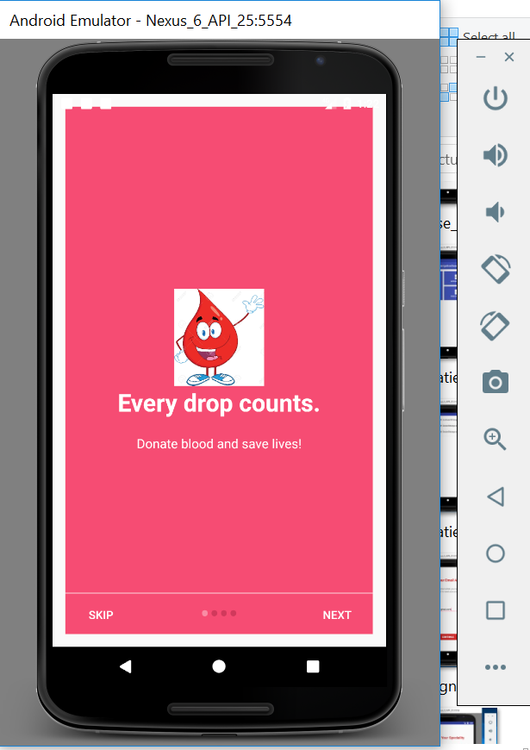
Blood Bank
In the left hand navigation of patient, click on the blood donor to open the blood donor app.

Slide 22
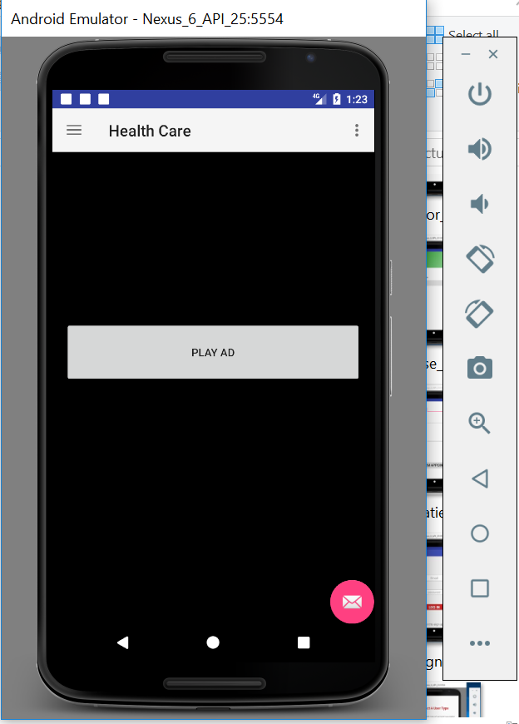
Blood Bank Dashboard
The blood donor dashboard opens, on click of play ad; the user would see a youtube video play.

Slide 23
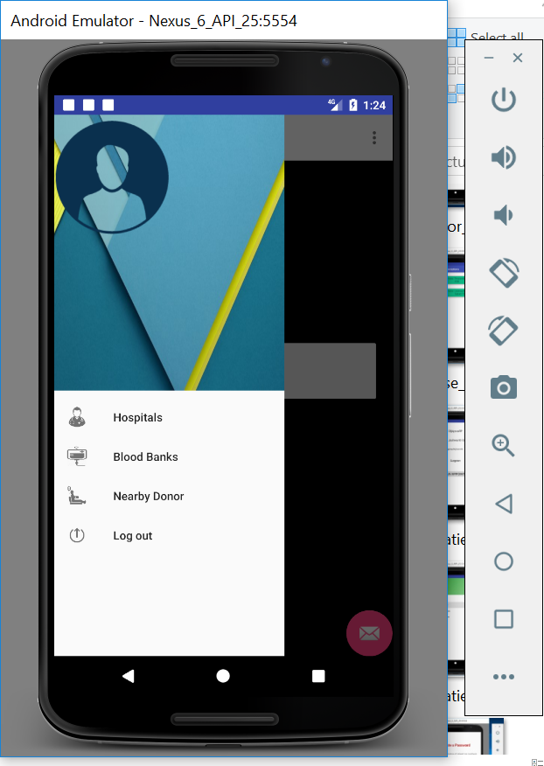
Blood Bank Left Hand Navigation
This is the left hand navigation of the blood donor.
On click of hospitals, it displays a list of hospitals.
On click of blood banks, it displays a list of blood banks.
On click of nearby donor, it displays a list of all the blood donors.

Slide 24
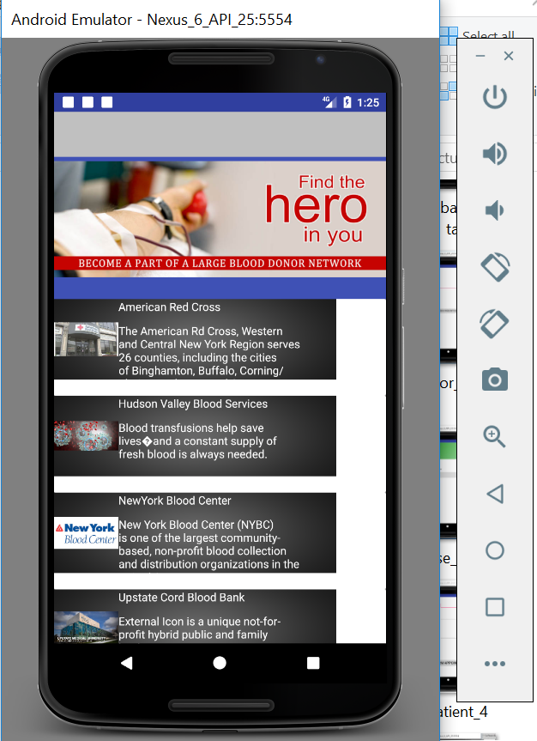
Blood Bank Details
On click of blood banks in the left hand navigation, it displays a list of blood banks.

Slide 25
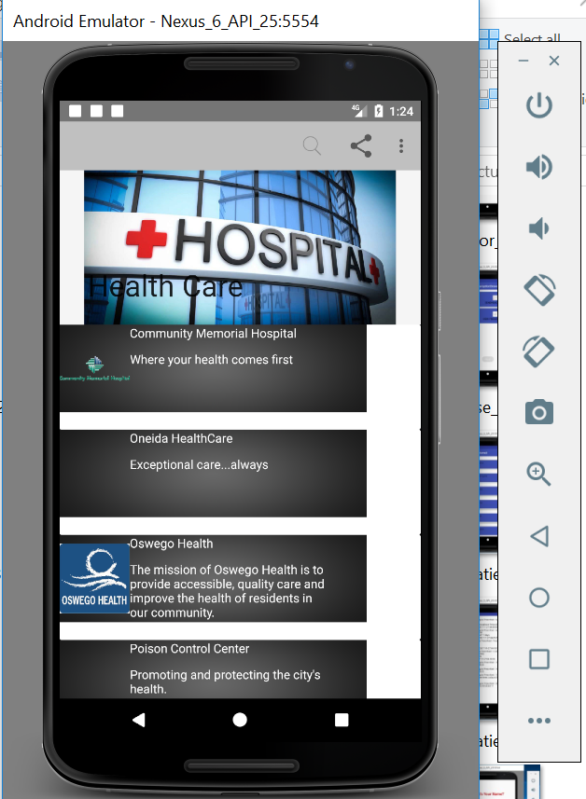
Blood Bank Details
On click of hospitals in the left hand navigation, it displays a list of hospitals.

Slide 26
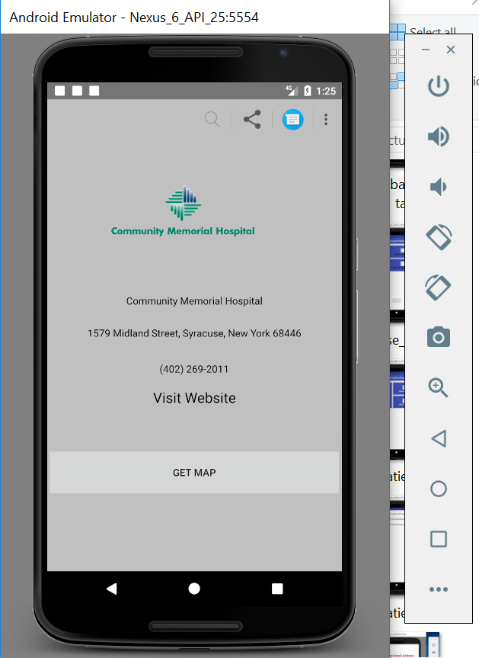
Blood Bank Hospital Details
On click of any hospital or blood bank, we get the contact details and the also can visit the website.

Slide 27
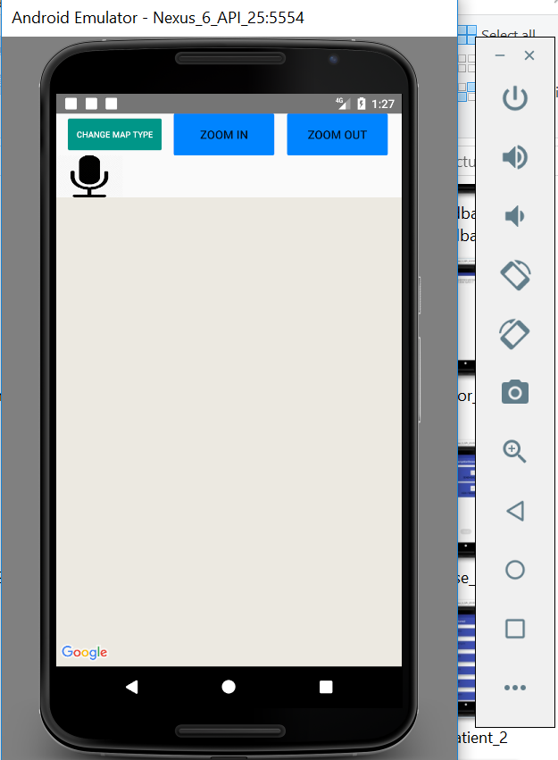
Blood Bank Hospital Details(Contd.)
On click of get map for blood banks or hospitals, we get the location details of the hospital and the blood bank.

Slide 28
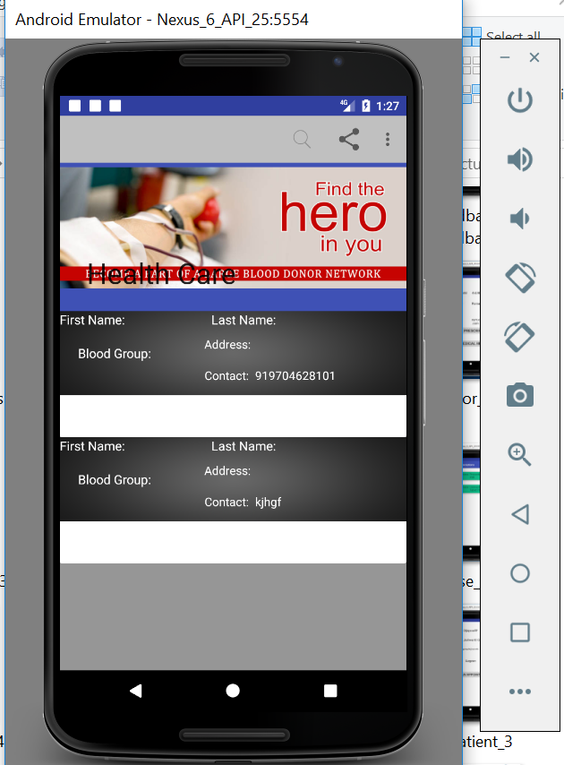
Blood Bank Donor Details
On click of the nearby donors, we get the list of all the donors.

Slide 29
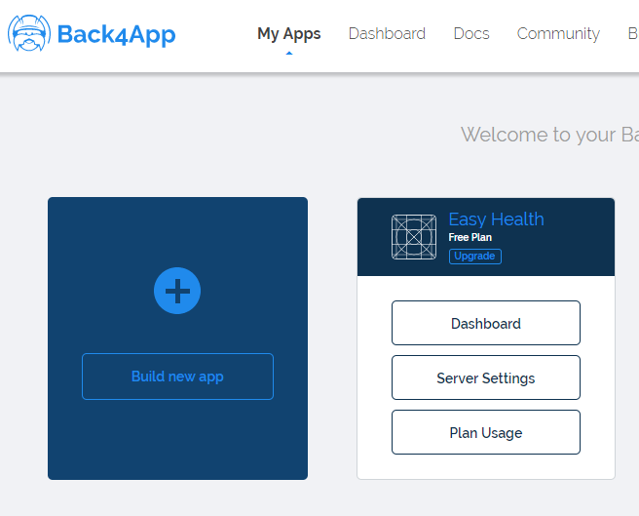
Database for EasyHealth App
Go to https://www.back4app.com/.
Login with below credentials:
username/emailaddress:
jashwanthreddy09@gmail.com
Password: easyhealth
Click on Dashboard below the Easy Health tab

Slide 30
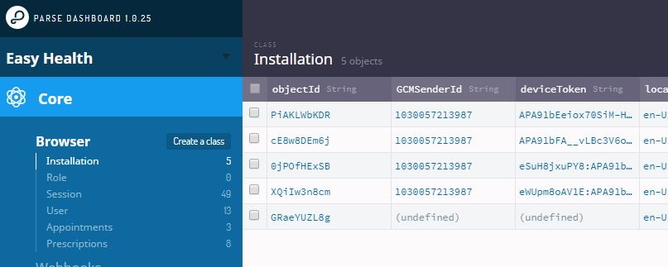
Database for EasyHealth App(Contd.)
As seen in the image, you can see the tables that are being used for the EasyHealth app.
For example: Prescriptions and Appointments tables.

Slide 31
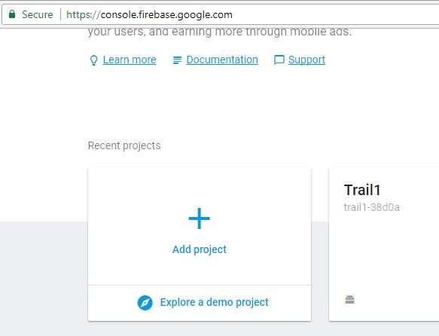
Database for Blood Donor
Go to https://console.firebase.google.com
Login with the following credentials:
username/emailaddress:
rishitmuthyala888@gmail.com
Password: jfkB_2016
Select Trail1 from the projects
Select Database from the left hand navigation

Slide 32
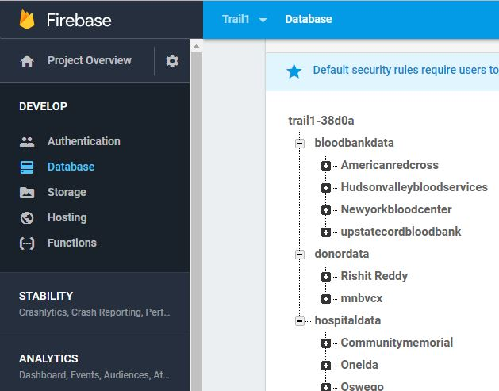
Database for Blood Donor
On the right hand side, you can select and the explore the bloodbankdata, donordata and hospitaldata tables that are being used for the Blood Donor.

Slide 33
THANK YOU!!

